Slide 1
NEW TONERS
NEW CHALLENGES
NEW OPPORTUNITIES

Slide 2
AGENDA
Market Update and Company Introduction
New Generation Toners Technology
Tackling OEM challenges with aftermarket solutions
Health, Saftety & Environment

Slide 3
Market Update and Company Introduction

Slide 4
IMEX Company Introduction
Japanese Toner Manufacturer, established 1982 by Akira Kitaoka
Owner managed company with vision and commitment to the imaging aftermarket industry
Continuous Investments in people, equipment and technologies
Innovative mindset. Trying to establish unique technical approaches

Slide 5
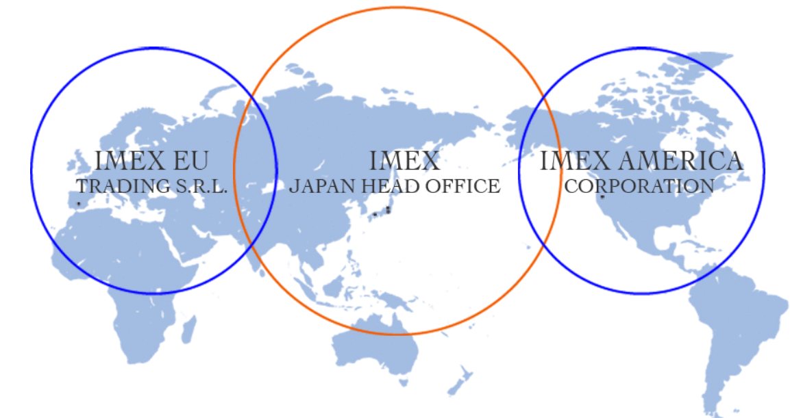
IMEX Global Locations

Slide 6
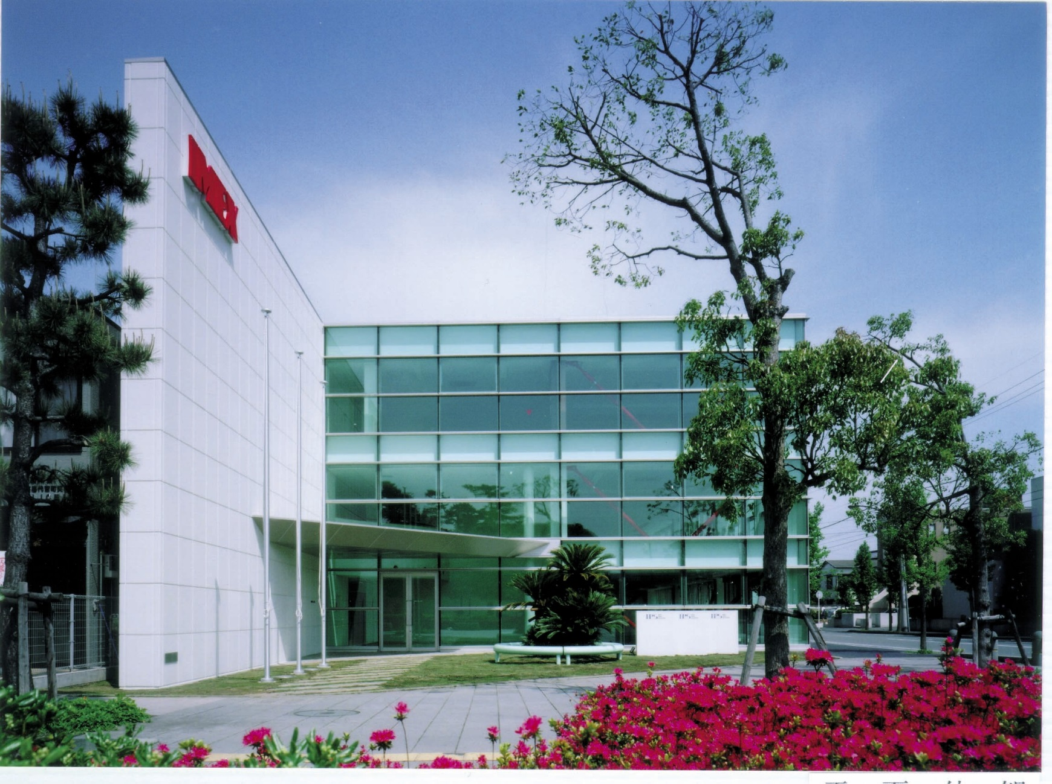
Hiratsuka Headoffice

Slide 7
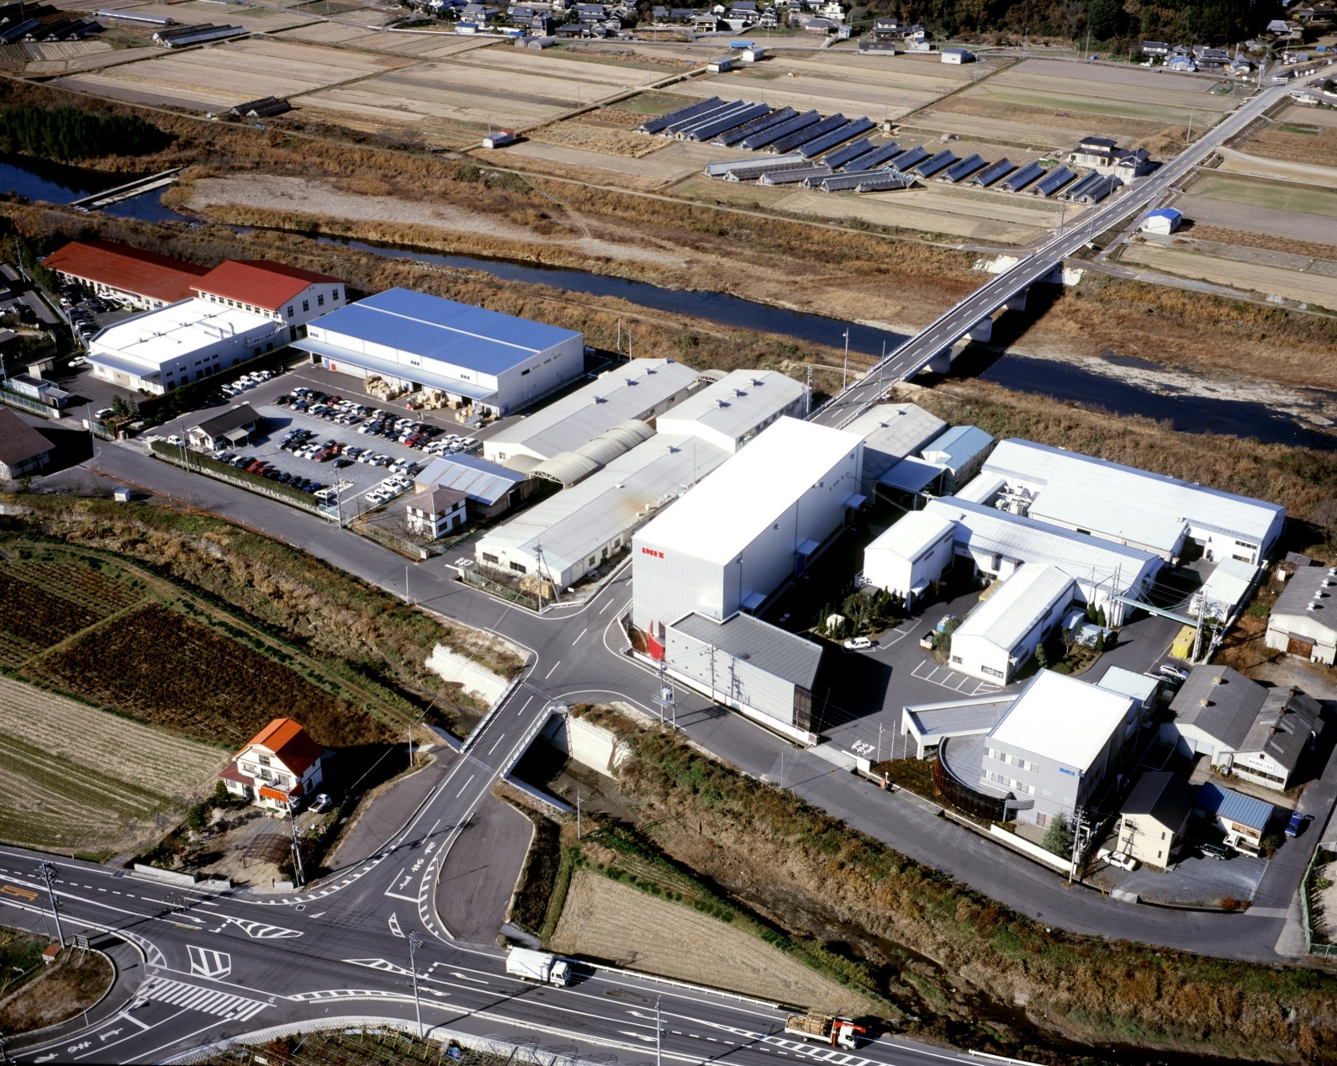
Okayama Factory

Slide 8
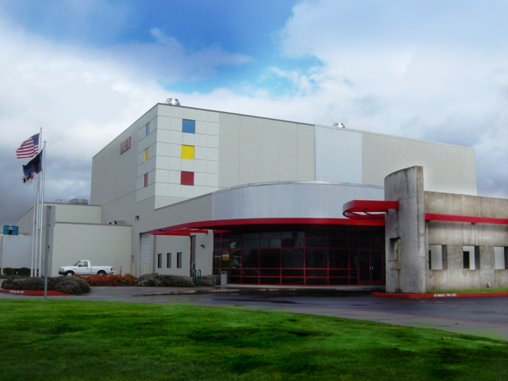
IMEX America Corperation

Slide 9
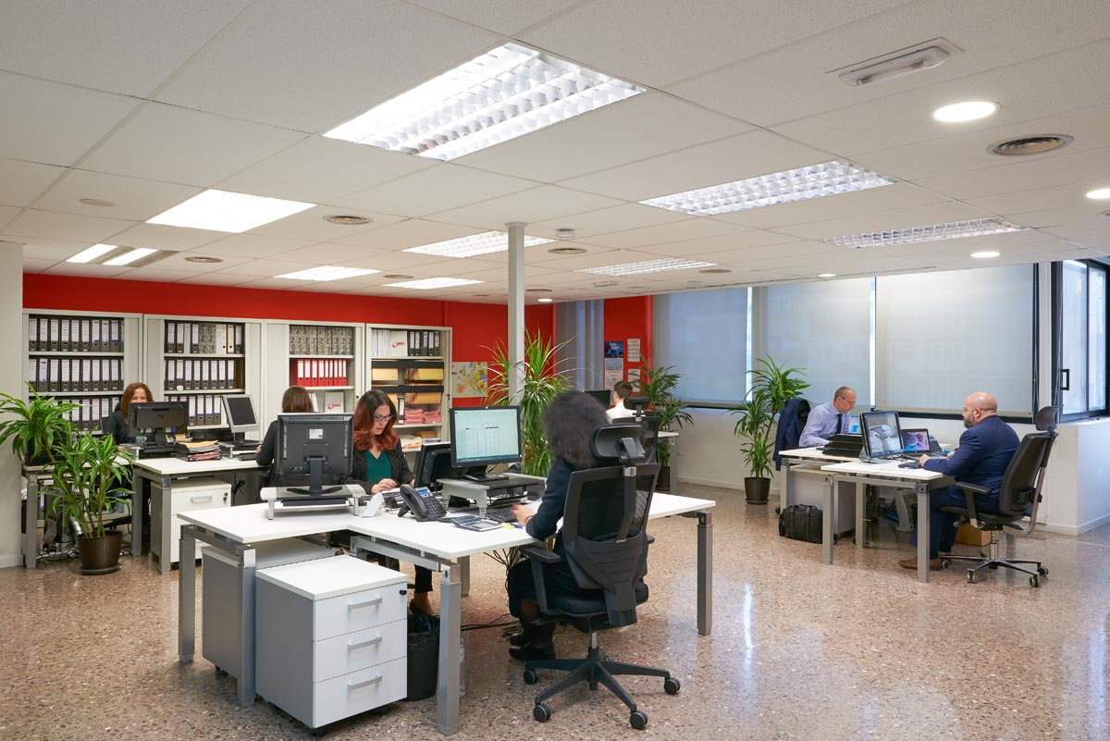
IMEX European Offices

Slide 10
New Generation Toners Technology

Slide 11
New Generation Technology
Low temperature fusing
Crucial for high speed, energy efficient printing environments as utilised by the new generation MFPs.
High transfer efficiency
Is a key factor in modern printing systems which improves cartridge life, reduces waste toner and prevents toner leakage from the waste section.
Robustness and stability
Durable toner enables MFPs and printers to maintain long life and have less need for field servicing. This durability is one of the key success factors for MPS systems

Slide 12
Low Temperature Fusing
Almost all of the latest MFPs and printers are now designed with low energy consumption and high speed printing specifications.
Machine manufacturers are dedicating more development resources to MFPs which require the use of low temperature fusing toners

Slide 13
Resin Technology
Lower fusing temperatures necessitate the need for lower temperature fusing resins
IMEX latest releases utilise polyester resins to meet these lower fusing temperatures and provide a close match to the OEM with:
Wide fusing window
Improved fusing on a wider range of papers
Less fuser fouling
Low VOC compared to Styrene Acrylic resins

Slide 14
IMEX Polyester Toner vs Styrene Acrylic

Slide 15
Transfer Efficiency
Technologies: SFS – Heat particle shaping
MST – Mechanical particle shaping
Fine materials dispersion and optimised post additive design
for charge stability and consistent image quality over the cartridge life.
Benefits are longer cartridge life, less waste toner, reduced possibility of toner leakage

Slide 16
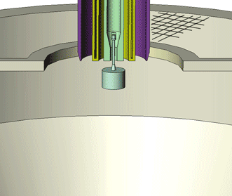
Heat shaping process

Slide 17
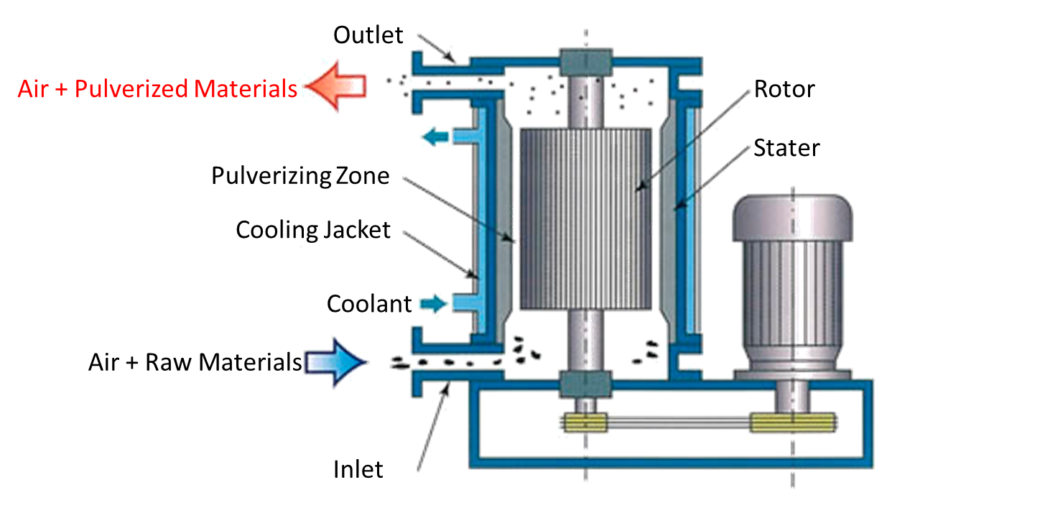
Mechanical shaping process

Slide 18
Transfer Efficiency / Particle Shaping
Print Quality
IMEX Spherical Toner
Even Print Image
Conventional Toner
Uneven
Print
Notes:
・トナーの円形度が向上すると転写効率は向上
・トナーの円形度が向上するとトナー1gあたりの印字枚数、つまりイールドが向上

Slide 19
Merits of IMEX SFS/MST technology
Conventional Toner
IMEX Spherical Toner
DB
DB
DVR
DVR
Irregular toner layer on DVR
Lower toner charging
Poor BG, dusting
Thinner and regular toner layer on DVR
Higher toner charging
Higher print quality without BG and dusting

Slide 20
Merits of IMEX SFS/MST technology
Conventional Toner
IMEX Spherical Tner
OPC
OPC
Character voids
Lower Transfer Efficiency
More waste
Increaed leakage risk
Higher Transfer Efficiency
Less waste
Reduced leakage
Notes:
転写工程
・不定形トナー；感光体表面との付着性が高く、紙への転写性に劣る。さらに帯電性も不均一でさらに転写性を落とす。
・球状トナー；感光体との付着性が低下、帯電性の均一になり転写性が向上

Slide 21
Robustness and stability – post additive blending
Post additives protect the toner surface from physical impact and subsequent build up on cartridge components. IMEX applies up-to-date material, optimized post additive formulas and blending processes for robust surface protection.
Benefit
Long life surface protection
Reduced component wear
Robust on worn/used components

Slide 22
Tackling OEM challenges
with aftermarket solutions

Slide 23
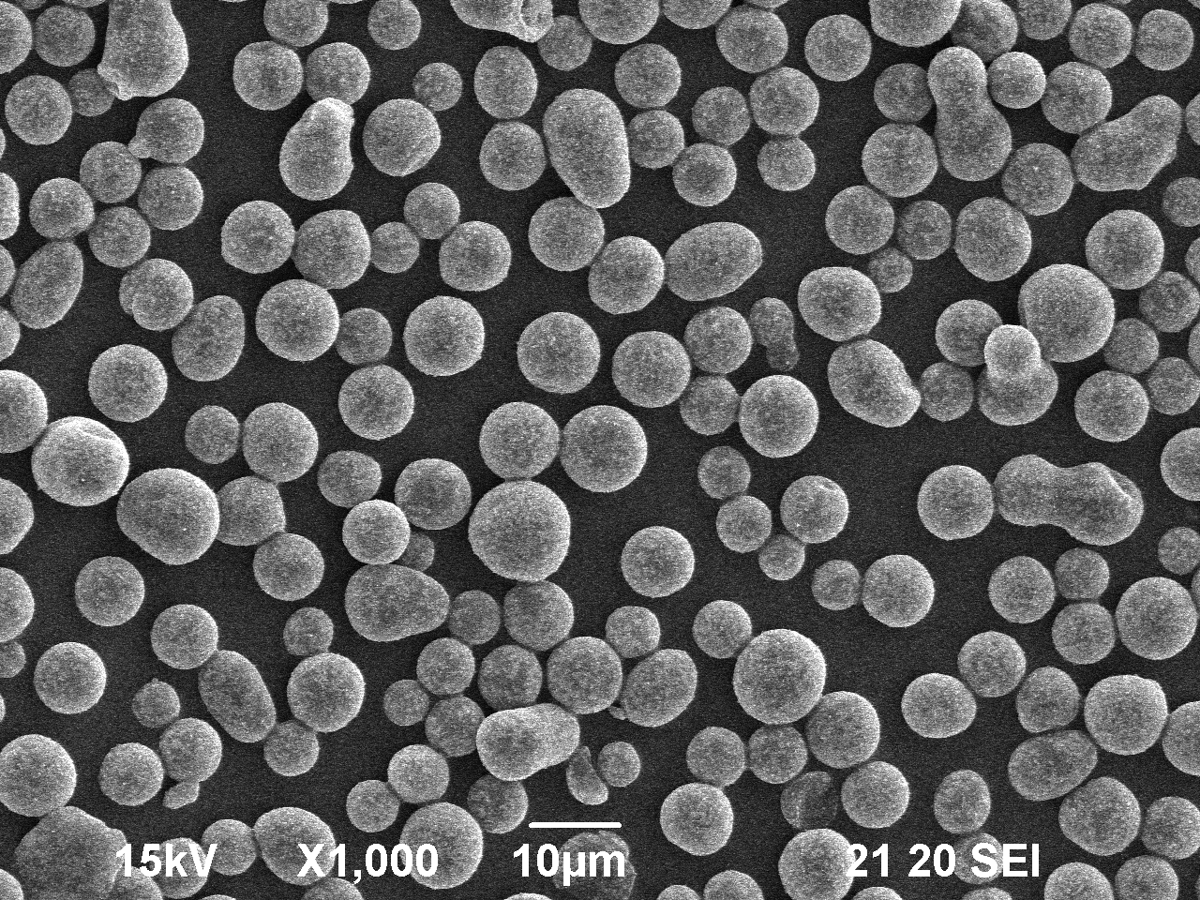
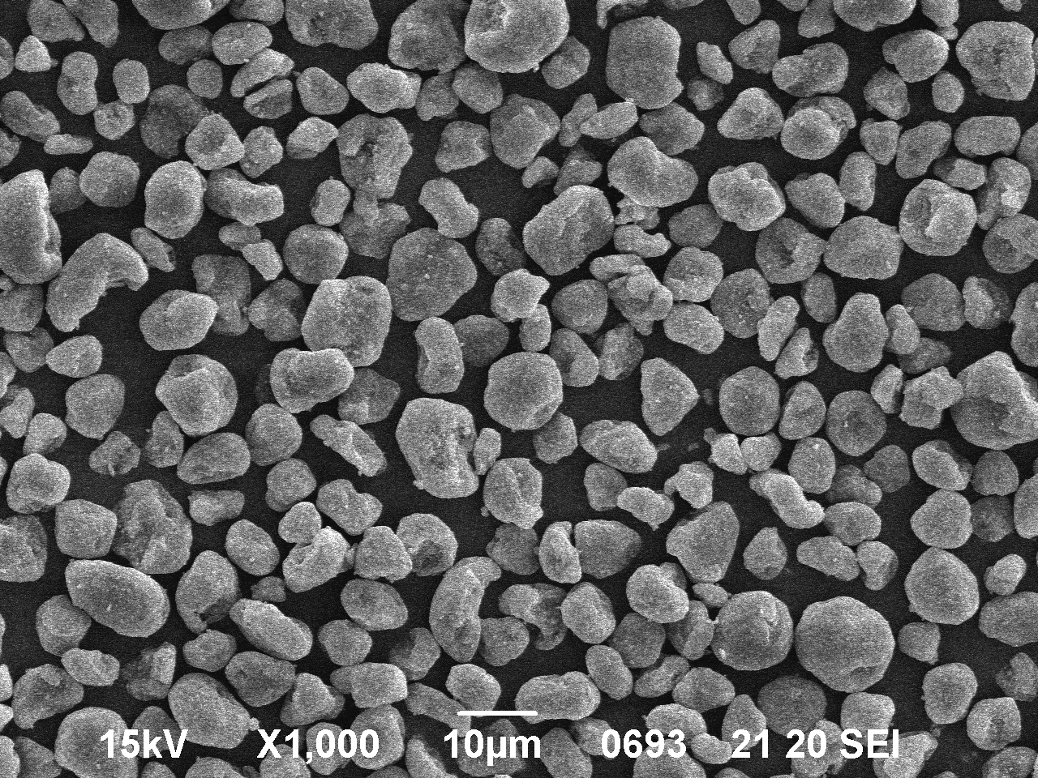
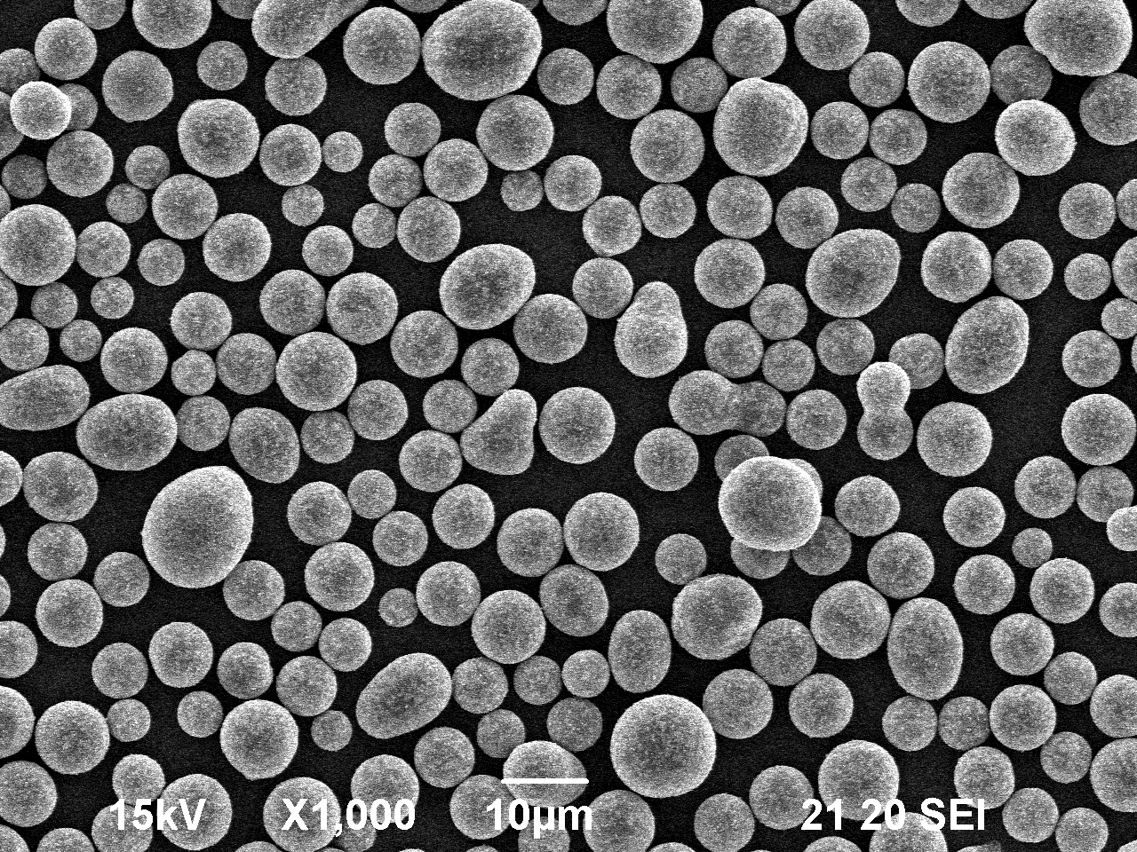
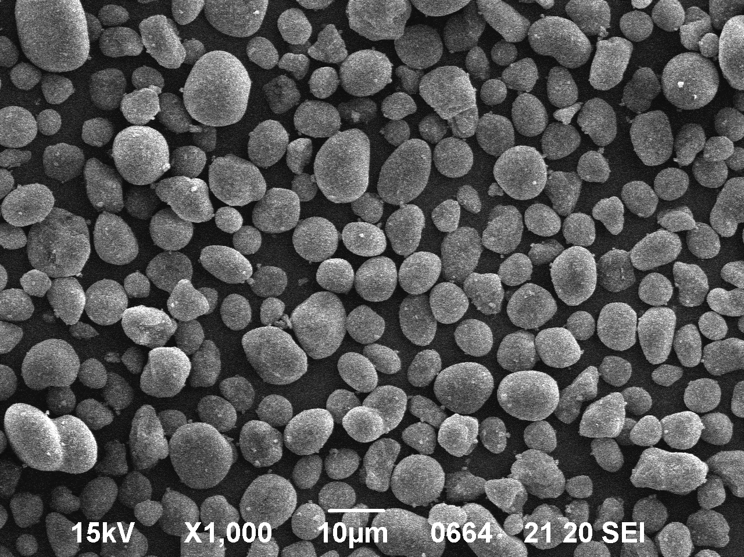
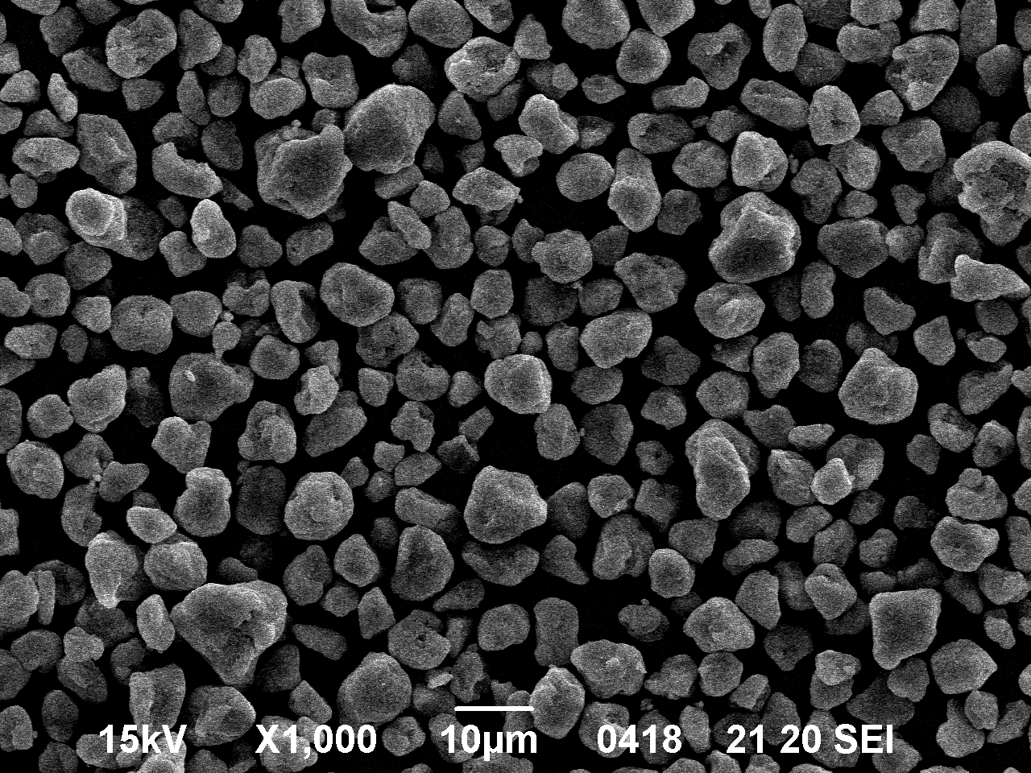
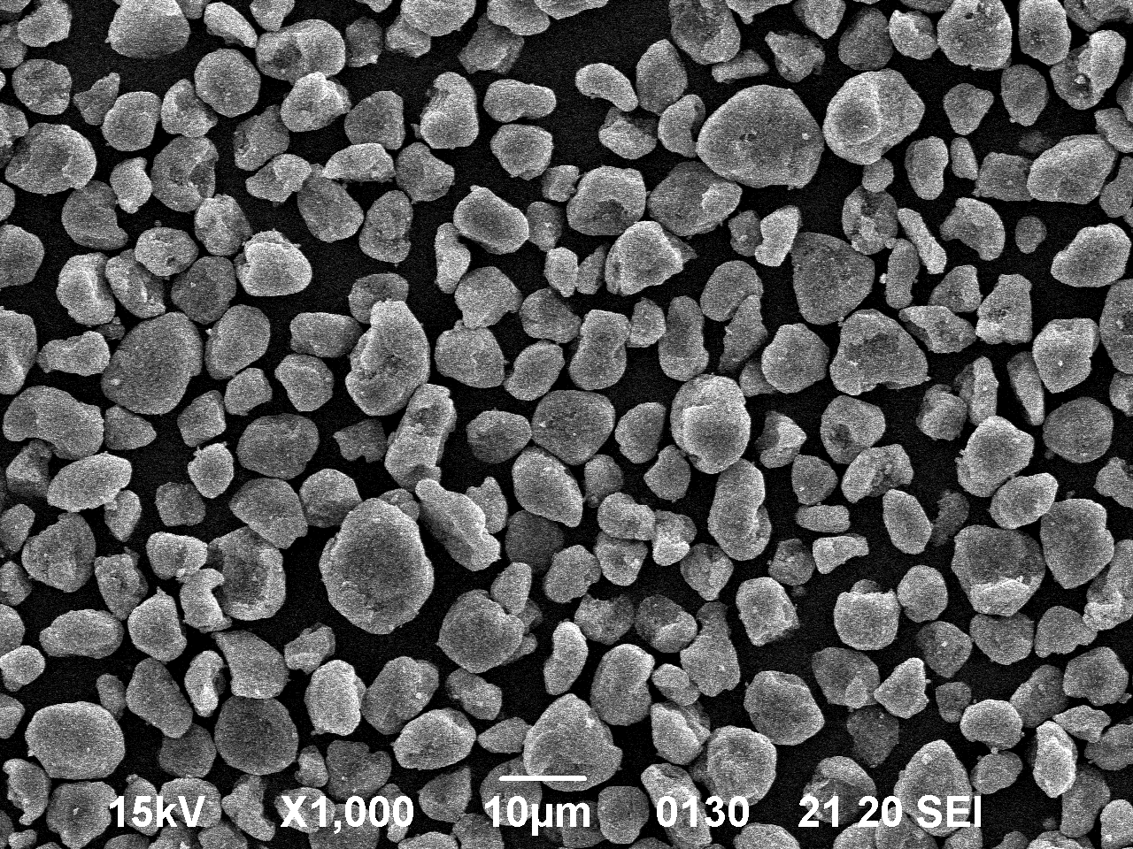
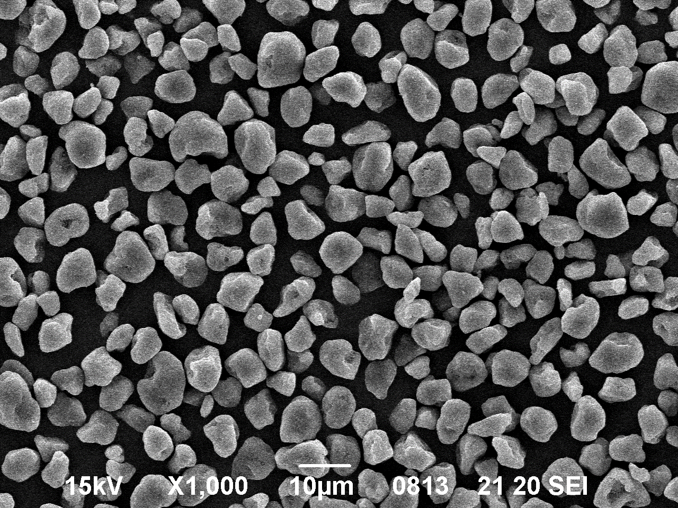
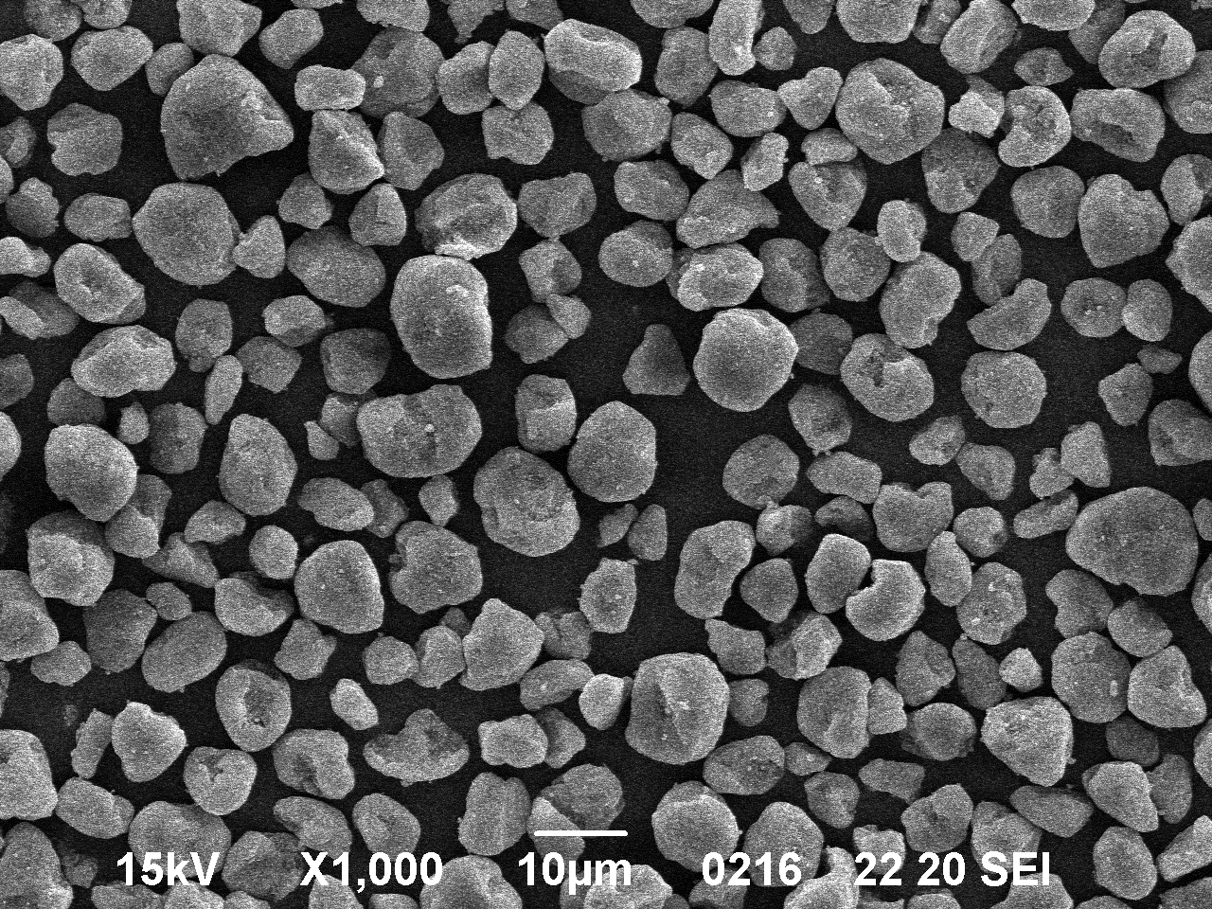
New monochrome technology types IMEX solutions to OEM technologies.
Machine | IMEX toner reference | Toner technology utilised
 |  | OEM | Micrograph | IMEX | Micrograph
M402/426/526/527 | AKO3 | Suspension Polymerisation |  | Mechanically spheroidized Polyester based
M102/203 | AJI | Suspension Polymerisation |  | Heat spheroidized Polyester based
M601/606 | ERO3 | Conventional |  | Conventional Polyester based
M607/8/9 | TAI | Conventional |  | Conventional Polyester based

Slide 24
AJI – M102/203 type toner
IMEX OEM
Heat spheroidized to match OEM print performance.
M102/203 has contact development and no cleaning blade which requires uniform tribocharge and higher transfer efficiency in order to prevent background.
Heat spheroidization achieves a more uniform circularity enabling the above.
Polyester based for superior fusing in low energy fusing systems with low fuser fouling/less wear.
Low VOC emissions
Notes:
・ポリエステルベースのため、AJIもLow VOC emissionsです。
・従来のジャンピング現像方式と異なり、接触現像方式、且つクリーナレスシステムのため、
従来の磁性トナーより、カブリ抑制のため均一な帯電性、及び高転写効率が求められる。
それを達成するため、AJIトナーは熱球形化を行っている。

Slide 25
AKO3 – HP M402/506 type toner
IMEX OEM
Mechanically spheroidized to match OEM performance
Polyester based – superior fusing in low energy fusing systems and over a wide range of substrates with low fuser fouling/less wear
Low VOC emissions
Notes:
・ポリエステルベースのため、AJIもLow VOC emissionsです。

Slide 26
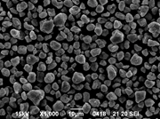
ERO3 – HP M606/HP4515
IMEX OEM
Conventional particle shape – No OPC contact to developer brush = low background development
Polyester based – superior fusing in low energy fusing systems and difficult substrates (labels/Heavier papers) with low fuser fouling/less wear.
Low VOC emissions.
Pulverized and non spherical particles – robust on worn components
Notes:
・Conventional ‘jumping toner technology’ は昔からの当たり前のことなので、記載しなくても良いと思います。

Slide 27
TAI – HPM607/8/9/ E60055/E60065/E60075
IMEX OEM
Conventional particle shape – Non OPC contact by developer brush = low background development
Polyester based – superior fusing in low energy fusing systems and over a wide range of substrates with low fuser fouling/less wear
Low VOC emissions
Pulverized and non spherical particles – extremely robust on worn components
Notes:
・Conventional ‘jumping toner technology’ は昔からの当たり前のことなので、記載しなくても良いと思います。

Slide 28
Health, Safety & Environment

Slide 29
Health and Safety
Recently the awareness on health and safety related issues increased in our industry.
It became evident that an increasing share of consumables circulating in our market are posing a risk to the physical integrity of users and processors.
The issue spans from the quality of plastics of the NBC empty cores to the composition of toners, which can be harmful to health through emissions.
There are international standards which help ensuring to use and distribute safe products and should be respected by responsible manufacturers.

Slide 30
LGA
German independent test lab, part of TÜV Rheinland which test is basis for Nordic Swan & Blue Angel.
IMEX toner goes through tests for:
RAL-UZ 177 requirements (Recycled toner modules for use in electrophotographic office equipment with printing function) Heavy metals, Azo dyes (for colour)
Test for contaminants including TVOC
IMEX Group sends all new launched toners to TÜV for LGA certificates

Slide 31
Blue Angel
The Federal Ministry of the Environment, Nature Protection and Nuclear Safety (Germany)
First and oldest environment-related label in the world (1977)
Based on RAL-UZ 177 test
Appendix 2 prepared by toner cartridge sellers, Appendix 3 by toner manufacturers Requirements R2 to R6 (CLP, SVHC, Heavy metals, Aromatic amines residues, TVOC)

Slide 32
Nordic Swan
The Nordic Council of Ministers
Available for around 60 product groups including “remanufactured OEM toner cartridges)
Having a Nordic Swan ecolabel means: less waste, lower consumption of energy and raw materials, high standards of quality throughout the product’s lifecycle.

Slide 33
RoHS (Restriction of Hazardous Substances)
EU Directive
Restricts the use of specific hazardous materials found in electrical and electronic products (known as EEE).
RoHS 2 is a recast of RoHS, extension applying to cover all electrical equipment and spare parts including toner cartridges ( by 22Jul 2019) and also a CE marking directive

Slide 34
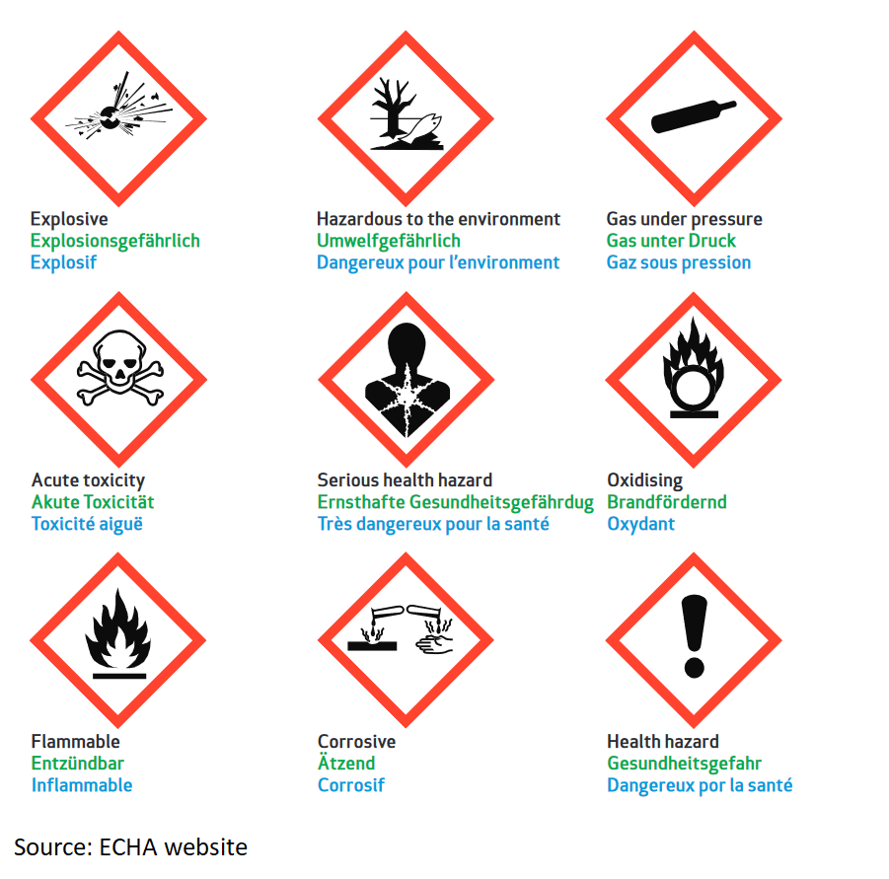
CLP Classification, Labelling and Packaging
EU regulation (No 1272/2008) in line with the United Nation’s Globally Harmonised System (GHS)
Since 1 June 2015, CLP is the only legislation in the EU for classification and labelling of substances and mixtures

Slide 35
IMEX Contribution on health, safety and quality
We are respecting the health and well being of our products end-users and ensure during development phase that our products are complying with the latest international standards.
IMEX toners are designed to be fully compliant with REACH, LGA, Blue Angel and Nordic Swan. We comply with CLP regulation and our products are ready for RoHS as well.
Throughout the production process great care is taken to ensure that each product conforms to its tightly controlled specification and in accordance with our ISO accreditation.

Slide 36
спасибо

