Slide 1
NEW GENERATION TONERS

Slide 2
IMEX Company Introduction
Japanese Toner Manufacturer, established 1982 by Akira Kitaoka
Owner managed company with vision and commitment to the imaging aftermarket industry
Continuous Investments in people, equipment and technologies
Innovative mindset. Trying to establish unique technical approaches

Slide 3
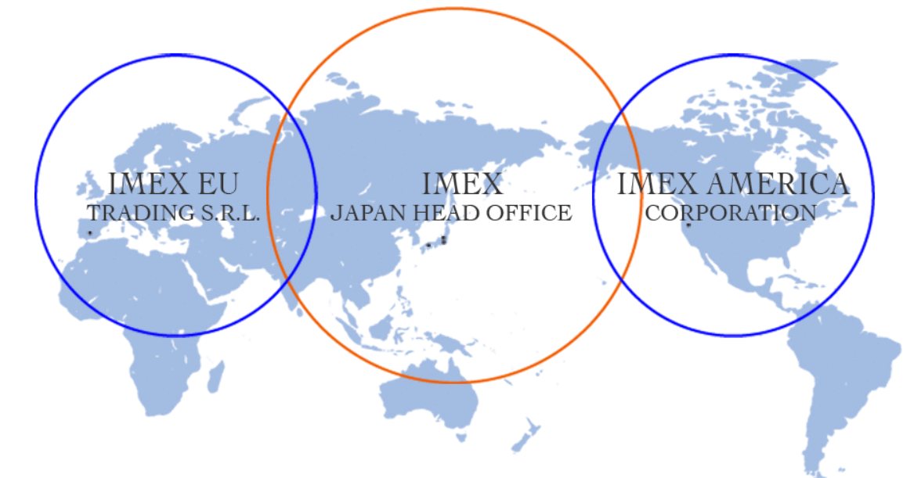
IMEX Global Locations

Slide 4
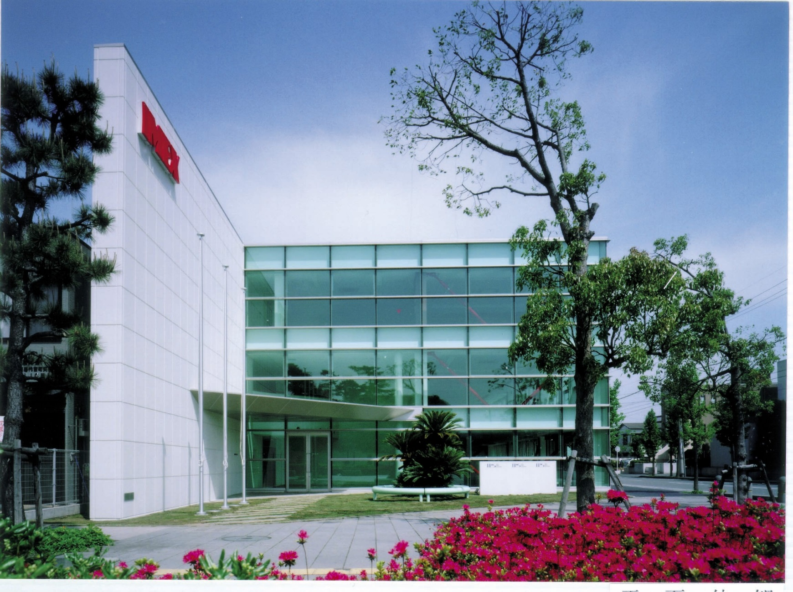
Hiratsuka Headoffice

Slide 5
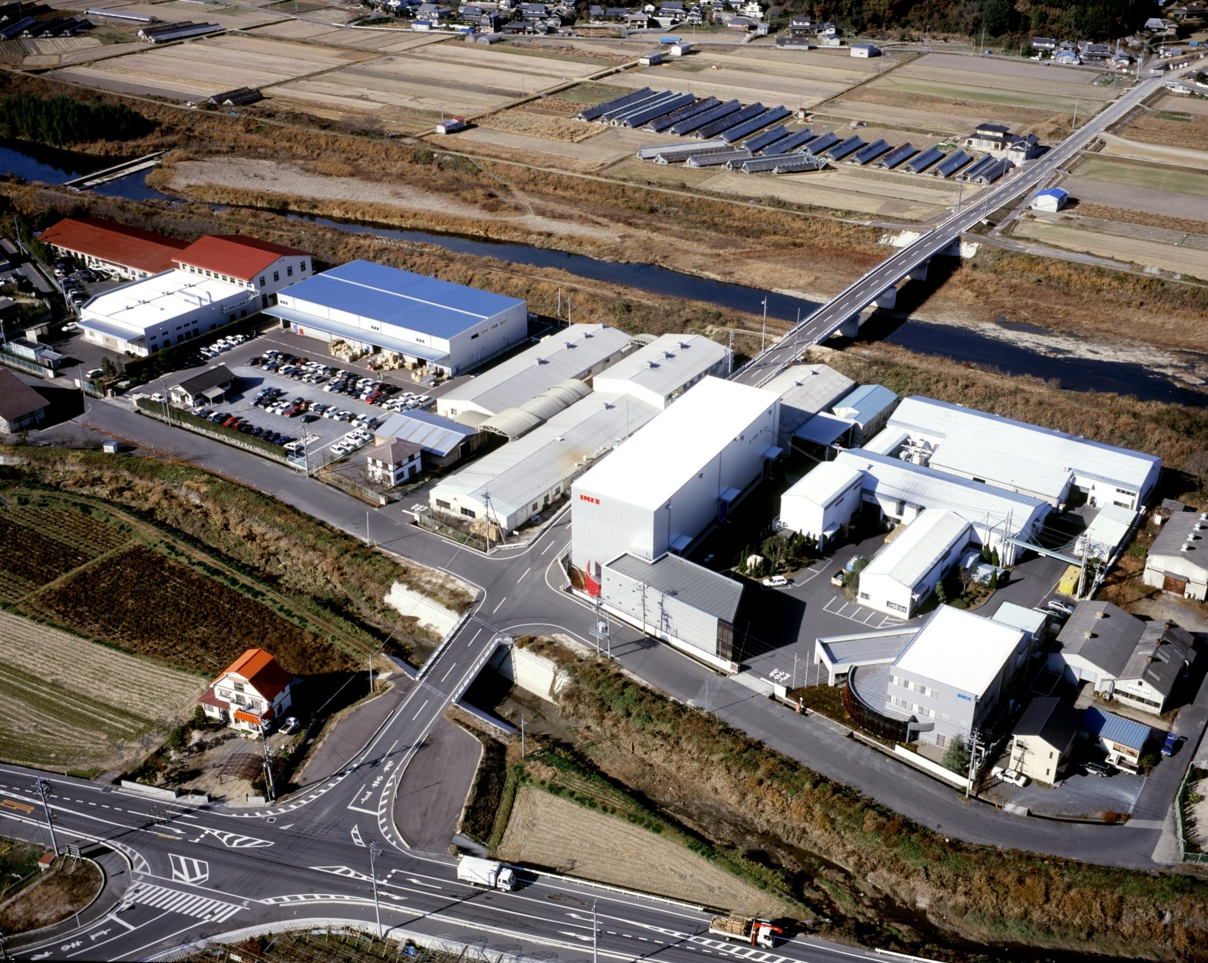
Okayama Factory

Slide 6
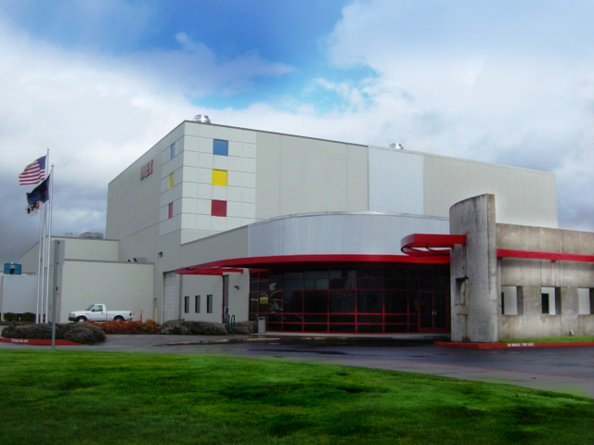
IMEX America Corperation

Slide 7
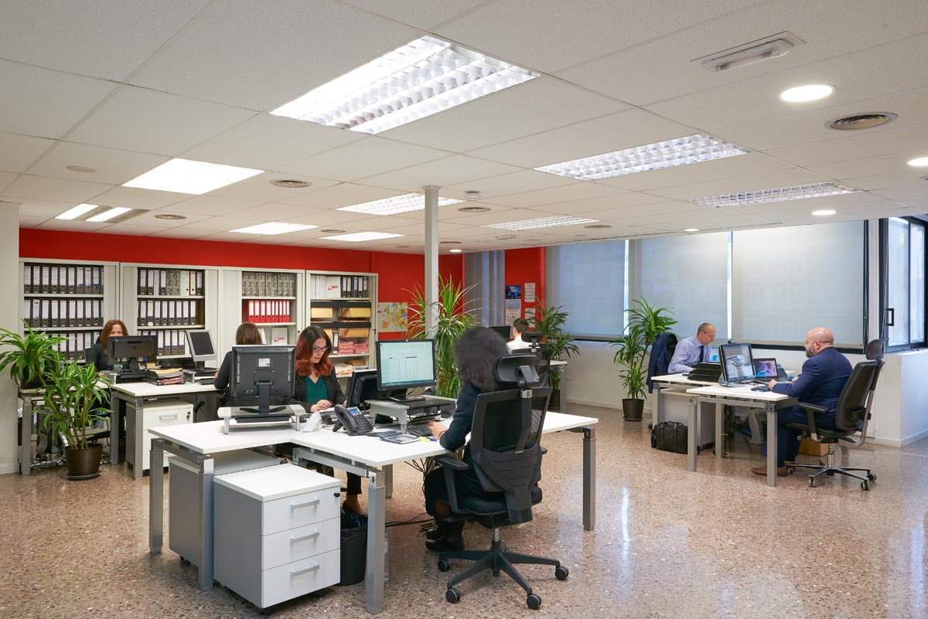
IMEX European Offices

Slide 8
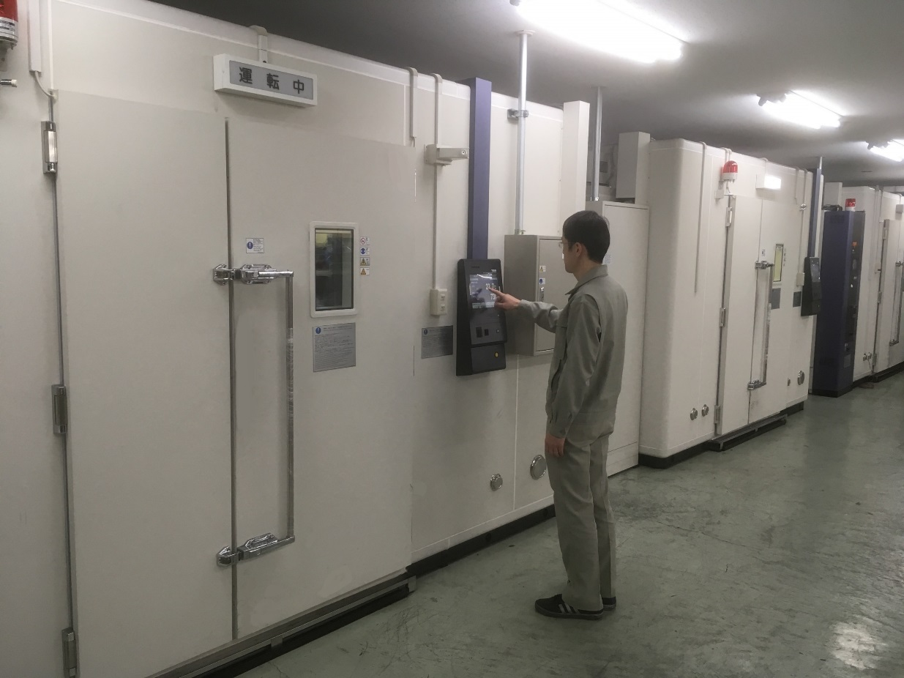
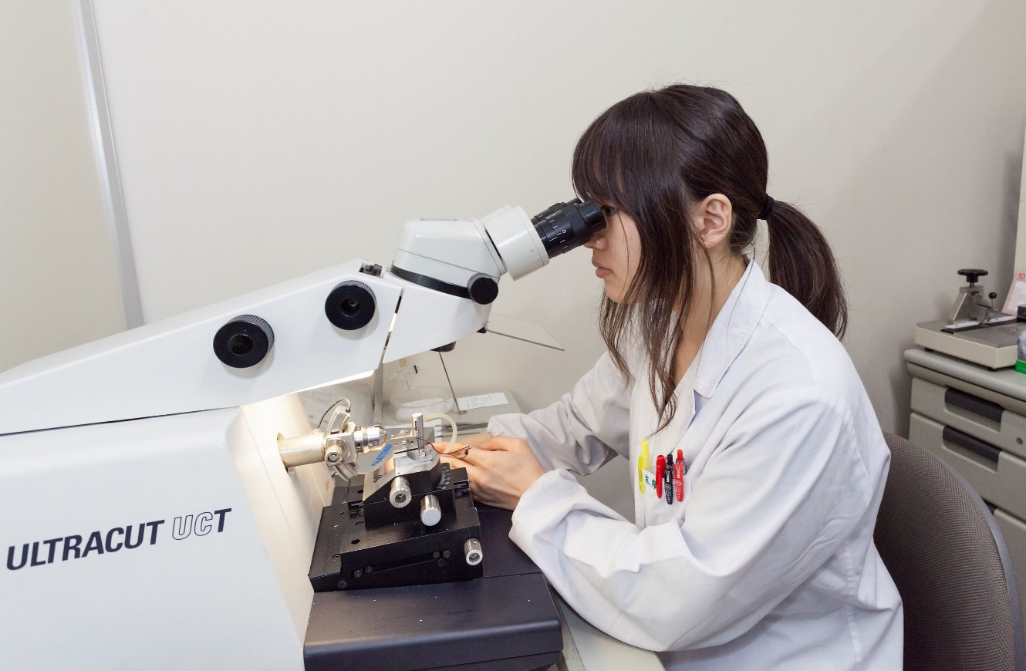
Critical R&D Devices
Mastertextformat bearbeiten
Zweite Ebene
Dritte Ebene
Vierte Ebene
Fünft
Climatic Chambers
Ultramicrotome

Slide 9
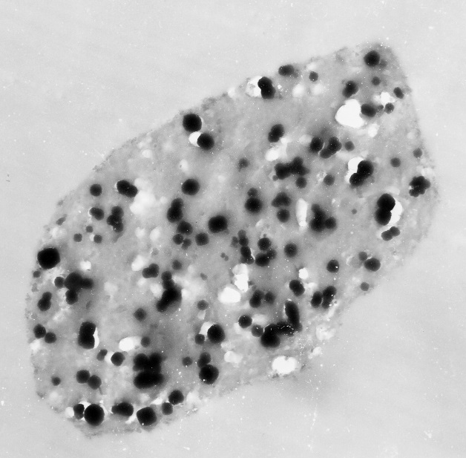
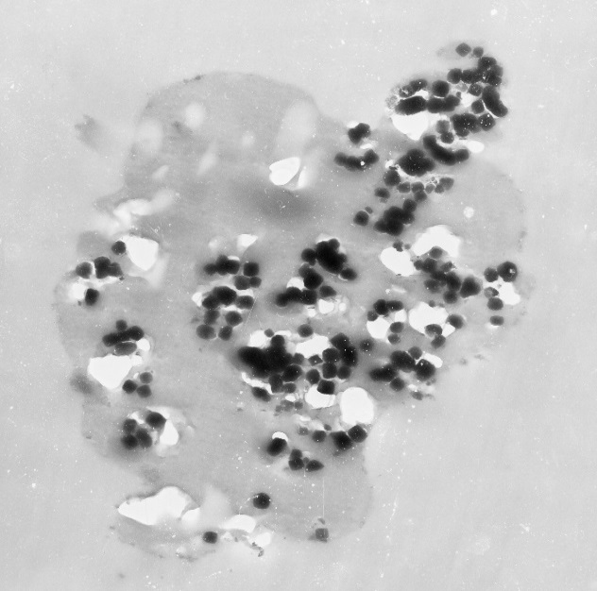
Critical R&D Devices
TEM Microscope

Slide 10
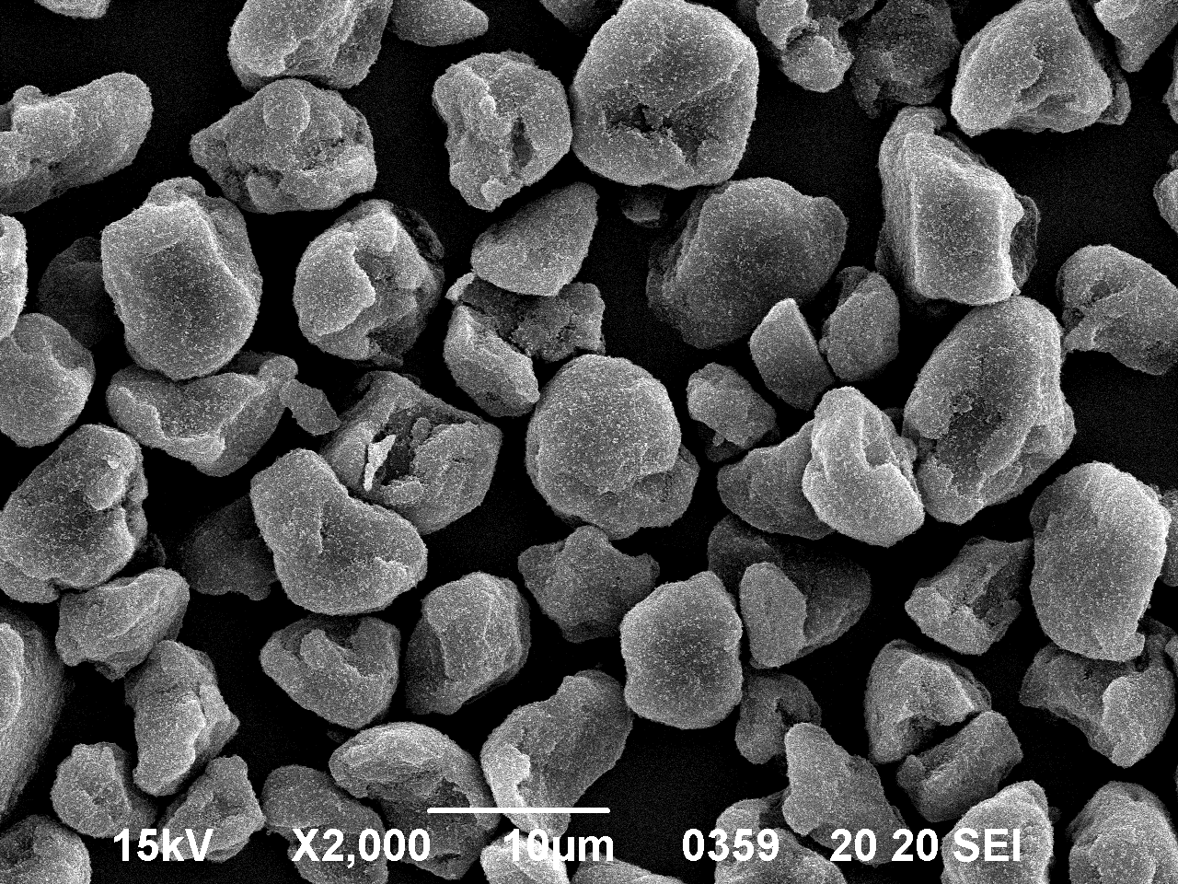
Critical R&D Devices
SEM Microscope

Slide 11
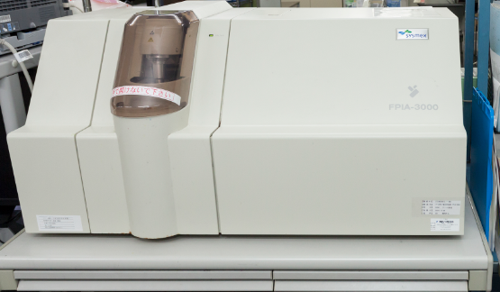
Critical R&D Devices
Image Xpert
FPIA

Slide 12
New Generation Toner Technology

Slide 13
New Generation Technology
Low temperature fusing
Crucial for high speed, energy efficient printing environments as utilised by the new generation MFPs.
High transfer efficiency
Is a key factor in modern printing systems which improves cartridge life, reduces waste toner and prevents toner leakage from the waste section.
Robustness and stability
Durable toner enables MFPs and printers to maintain long life and have less need for field servicing. This durability is one of the key success factors for MPS systems

Slide 14
Low Temperature Fusing
Almost all of the latest MFPs and printers are now designed with low energy consumption and high speed printing specifications.
Machine manufacturers are dedicating more development resources to MFPs which require the use of low temperature fusing toners

Slide 15
Resin Technology
Lower fusing temperatures necessitate the need for lower temperature fusing resins
IMEX latest releases utilise polyester resins to meet these lower fusing temperatures and provide a close match to the OEM with:
Wide fusing window
Improved fusing on a wider range of papers
Less fuser fouling
Low VOC compared to Styrene Acrylic resins

Slide 16
IMEX Polyester Toner vs Styrene Acrylic

Slide 17
Transfer Efficiency
Technologies: SFS – Heat particle shaping
MST – Mechanical particle shaping
Fine materials dispersion and optimised post additive design
for charge stability and consistent image quality over the cartridge life.
Benefits are longer cartridge life, less waste toner, reduced possibility of toner leakage

Slide 18
Transfer Efficiency / Particle Shaping
Print Quality
IMEX Spherical Toner
Even Print Image
Conventional Toner
Uneven
Print
Notes:
・トナーの円形度が向上すると転写効率は向上
・トナーの円形度が向上するとトナー1gあたりの印字枚数、つまりイールドが向上

Slide 19
Chemically made toners vs SFS/MST toners
Chemical toner production is a wet process utilising water and surfactant
Residual surfactant from the drying process will affect charge stability
Residual surfactant can lead to lot variations
Rounder particle shape and better size distribution
Production failures cannot be reworked which increases cost greatly
Not as robust on worn components

Slide 20
SFS/MST Technology vs chemically made toners
No use of water or surfactants which gives greater charge stability in high humidity.
Less lot to lot variation
No need mitigate charge instability at high humidity with complex post additive design
Less performance difference at extremes of temperature and humidity (HH, LL)
SFS/MST toners are more robust on worn components

Slide 21
Pulverised toner vs SFS/MST toners
Lower transfer efficiency
More waste generated
Reduced print resolution
Increased background risk
Greater leakage risk

Slide 22
Merits of IMEX SFS/MST technology
Conventional Toner
IMEX Spherical Toner
DB
DB
DVR
DVR
Irregular toner layer on DVR
Lower toner charging
Poor BG, dusting
Thinner and regular toner layer on DVR
Higher toner charging
Higher print quality without BG and dusting

Slide 23
Merits of IMEX SFS/MST technology
Conventional Toner
IMEX Spherical Tner
OPC
OPC
Character voids
Lower Transfer Efficiency
More waste
Increaed leakage risk
Higher Transfer Efficiency
Less waste
Reduced leakage
Notes:
転写工程
・不定形トナー；感光体表面との付着性が高く、紙への転写性に劣る。さらに帯電性も不均一でさらに転写性を落とす。
・球状トナー；感光体との付着性が低下、帯電性の均一になり転写性が向上

Slide 24
Robustness and stability – post additive blending
Post additives protect the toner surface from physical impact and subsequent build up on cartridge components. IMEX applies up-to-date material, optimized post additive formulas and blending processes for robust surface protection.
Benefit
Long life surface protection
Reduced component wear
Robust on worn/used components
Technologies
Post additive package formula - materials and design
Optimized blending process

Slide 25
Diligent quality control and total design concept
Throughout the production process great care is taken to ensure that each product conforms to its tightly controlled specification and in accordance with our ISO accreditation.
Our attention to detail ensures that our customers receive the highest image quality toners made with state of the art technology.
From the development of new products to final lot qualification, we constantly review every step of the process to ensure the best quality products.
Thank you.

